Slide 1
Physical Layer

Slide 2

Physical Layer
Deals with the transfer of data between two devices that are directly connected; that is, the two devices are linked by a single transmission path rather than a network.
Process of transmitting signals across a communications link.
Both analog and digital transmission techniques are used. In both cases, the signal can be described as consisting of a spectrum of components across a range of electromagnetic frequencies.
The transmission properties of the signal depend on which frequencies are involved. Also, the types of impairments, such as attenuation, that a signal suffers are dependent on frequency.

Slide 3


The physical layer has complex tasks to perform.
One major task is to provide services for the data link layer. The data in the data link layer consists of 0s and I s organized into frames that are ready to be sent across the transmission medium.
This stream of 0s and I s must first be converted into another entity: signals.
One of the services provided by the physical layer is to create a signal that represents this stream of bits.

Slide 4
Data Transmission: Concepts and Terminology

Slide 5




Transmission Terminology
Data transmission occurs between transmitter and receiver over some transmission medium.
Transmission media may be classified as guided or unguided. In both cases, communication is in the form of electromagnetic waves.
With guided media, the waves are guided along a physical path; examples of guided media are twisted pair, coaxial cable, and optical fiber.
Unguided media, also called wireless, provide a means for transmitting electromagnetic waves but do not guide them; examples are propagation through air, vacuum, and seawater.

Slide 6
Analog and Digital Data
Data can be analog or digital.
Analog data are continuous and take continuous values.
Digital data have discrete states and take discrete values.

Slide 7
Analog and Digital Signals
Signals can be analog or digital.
Analog signals can have an infinite number of values in a range.
Digital signals can have only a limited number of values.

Slide 8


Signals
A signal is an electric current or electromagnetic field used to convey data from one place to another.
Signal is generated by the transmitter and transmitted over a medium. A Transmitter encodes a message into a signal, which is carried to a receiver by the communications channel.
The signal is a function of time, but it can also be expressed as a function of frequency; that is, the signal consists of components of different frequencies.
The frequency domain view of a signal is more important to an understanding of data transmission than a time domain view.
Signals can be interpreted as either Analog or Digital

Slide 9
Analog Signals
An analog signal is one in which the signal intensity varies in a smooth fashion over time i.e., Analog signals are continuous, non-discrete

Slide 10

Digital Signals
A digital signal is one in which the signal intensity maintains a constant level for some period of time and then abruptly changes to another constant level i.e., Digital signals are non-continuous, discrete

Slide 11
Analog and Digital Signals
Analog Signals
Digital Signals
Continuous
Infinite range of values
More exact values, but more difficult to work with
Discrete
Finite range of values (2)
Not as exact as analog, but easier to work with
The analog value is continuous and more accurate, but the digital value is more than adequate for the application and significantly easier to process electronically.
Notes:
This slide defines analog and digital signals and gives several examples of each.

Slide 12
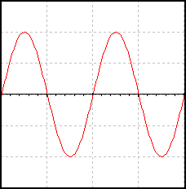
Parts of an Analog Signal
Period
(T)
Frequency:
Amplitude
(peak)
Amplitude
(peak-to-peak)
Notes:
Parts of an analog signal: amplitude, period, & frequency.

Slide 13





Logic Levels
A logic level is a voltage level that represents a defined digital state.
Logic HIGH: The higher of two voltages, typically 5 volts
Logic LOW: The lower of two voltages, typically 0 volts
5.0 v
Logic High
Logic Level | Voltage | True/False | On/Off | 0/1
HIGH | 5 volts | True | On | 1
LOW | 0 volts | False | Off | 0
2.0 v
Invalid
Logic
Level
0.8 v
0.0 v
Logic Low
Notes:
This slide introduces the concept of logic levels, gives the range of acceptable voltages for a logic high & low, and lists other common terms used to describe logic levels.

Slide 14
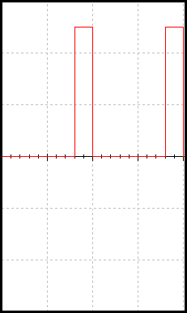
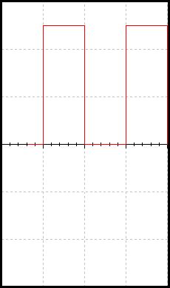
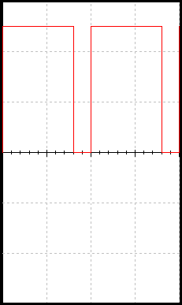
Example of Digital Signals
Digital signals are commonly referred to as square waves or clock signals.
Their minimum value must be 0 volts, and their maximum value must be 5 volts.
They can be periodic (repeating) or non-periodic.
The time the signal is high (t_{H}) can vary anywhere from 1% of the period to 99% of the period.
5 volts
0 volts
Notes:
Examples of common digital signals.

Slide 15
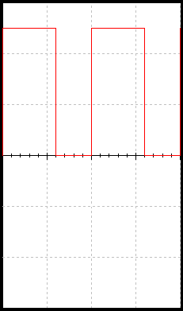




Parts of a Digital Signal
Amplitude:
For digital signals, this will ALWAYS be 5 volts.
Period:
The time it takes for a periodic signal to repeat. (seconds)
Frequency:
A measure of the number of occurrences of the signal per second. (Hertz, Hz)
Time High (t_{H}):
The time the signal is at 5 v.
Time Low (t_{L}):
The time the signal is at 0 v.
Duty Cycle:
The ratio of t_{H} to the total period (T).
Rising Edge:
A 0-to-1 transition of the signal.
Falling Edge:
A 1-to-0 transition of the signal.
Falling Edge
Amplitude
Time
High
(t_{H})
Time
Low
(t_{L})
Rising Edge
Period (T)
Frequency:
Notes:
The parts of a digital signal: amplitude, period & frequency, time high, time low, duty cycle, rising & falling edge.

Slide 16



Periodic and Nonperiodic Signals
Both analog and digital signals can take one of two forms: periodic or nonperiodic
A periodic signal completes a pattern within a measurable time frame, called a period, and repeats that pattern over subsequent identical periods. The completion of one full pattern is called a cycle.
A nonperiodic(aperiodic)signal changes without exhibiting a pattern or cycle that repeats over time.
In data communications, we commonly use periodic analog signals and non-periodic digital signals.

Slide 17

Periodic signals
a signal s(t) is defined to be periodic if and only if
where the constant T is the period of the signal (T is the smallest value that satisfies the equation).

Slide 18
Aperiodic signals

Slide 19


Periodic Analog Signals
Periodic analog signals can be classified as simple or composite.
A simple periodic analog signal, a sine wave, cannot be decomposed into simpler signals.
A composite periodic analog signal is composed of multiple sine waves.

Slide 20

Sine wave – most fundamental form of a periodic analog signal
Fully described by: Amplitude, Frequency and Phase
General sine wave

Slide 21


Amplitude
Absolute value of a signal’s highest intensity- proportional to the energy it carries.
Normally measured in volts

Slide 22

Period and Frequency
Period - amount of time to complete one cycle, expressed in seconds
Frequency – number of periods in one second
Period is the inverse of frequency, and frequency is the inverse of period

Slide 23
Frequency
Rate of change with respect to time, expressed in hertz (Hz)
Change in a short span of time means high frequency
Change over a long span of time means low frequency

Slide 24
Two Extremes
What if a signal does not change at all? What if it maintains a constant voltage level for the entire time it is active?
In such a case, its frequency is zero. If a signal does not change at all, it never completes a cycle, so its frequency is 0 Hz.
But what if a signal changes instantaneously? What if it jumps from one level to another in no time?
Then its frequency is infinite. In other words, when a signal changes instantaneously, its period is zero; since frequency is the inverse of period, in this case, the frequency is 1/0, or infinite (unbounded).

Slide 25


Phase
Position of the waveform relative to time zero
Measured in degrees or radians

Slide 26
Wavelength
Wavelength is another characteristic of a signal traveling through a transmission medium.
Wavelength binds the period or the frequency of a simple sine wave to the propagation speed of the medium
While the frequency of a signal is independent of the medium, the wavelength depends on both the frequency and the medium.
Wavelength is a property of any type of signal.

Slide 27


In data communications, we often use wavelength to describe the transmission of light in an optical fiber.
The wavelength is the distance a simple signal can travel in one period.
since period and frequency are related to each other
Wavelength = propagation speed / frequency = propagation speed * period
The wavelength is normally measured in micrometers (microns) instead of meters.
The propagation speed of electromagnetic signals depends on the medium and on the frequency of the signal.
For example, in a vacuum, light is propagated with a speed of 3 x 10⁸ m/s, speed is lower in air and even lower in cable.

Slide 28
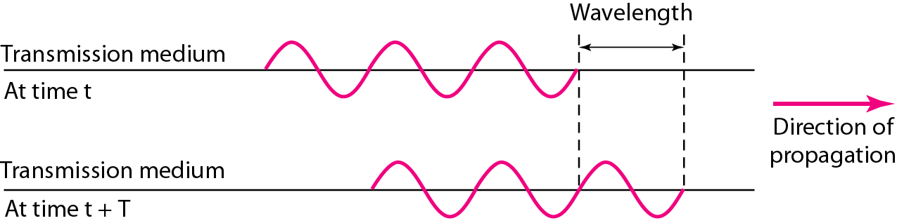
Wavelength and Period

Slide 29
Sine Wave examples

Slide 32








Square Wave

Slide 33


Time and Frequency Domains
Time-domain plot – displays changes in signal amplitude with respect to time
Frequency-domain plot –is concerned with only the peak value and the frequency i.e., relationship between amplitude and frequency
Best way to represent an analog signal

Slide 37


Composite Signals
Composed of many simple sine waves of differing frequencies
Fourier – showed any composite signal is a sum of a set of sine waves of different frequencies, phases, and amplitudes (Harmonics)
Fourier analysis

Slide 38



Harmonics – components of digital signal, each having a different frequencies, phases, and amplitudes
A harmonic is a signal or wave whose frequency is an integral (whole-number) multiple of the frequency of some reference signal or wave.
The term can also refer to the ratio of the frequency of such a signal or wave to the frequency of the reference signal or wave.

Slide 39
Composite signal can be periodic or nonperiodic.
A periodic composite signal can be decomposed into a series of simple sine waves with discrete frequencies
Frequencies that have integer values (1, 2, 3, and so on).
A nonperiodic composite signal can be decomposed into a combination of an infinite number of simple sine waves with continuous frequencies, frequencies that have real values.

Slide 40

If the composite signal is periodic, the decomposition gives a series of signals with discrete frequencies
if the composite signal is nonperiodic, the decomposition gives a combination of sine waves with continuous frequencies.

Slide 41
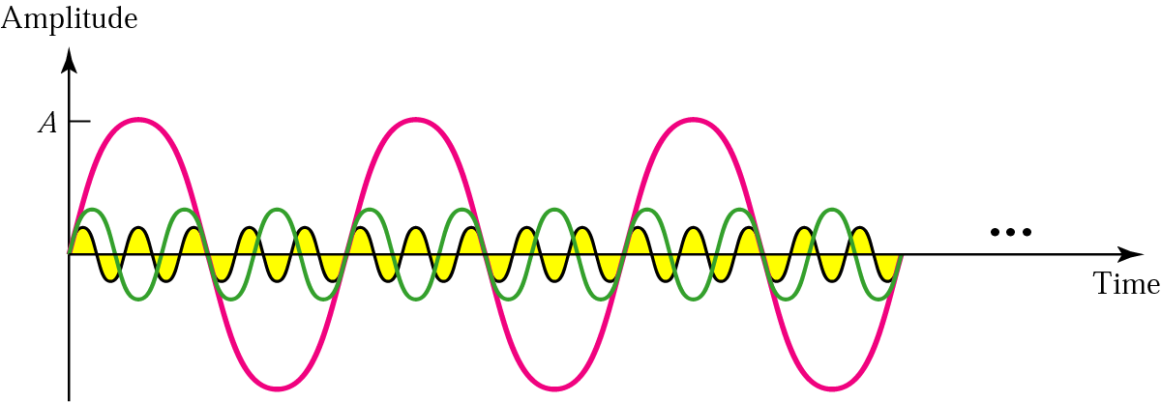
Three harmonics

Slide 42
Adding first three harmonics

Slide 43
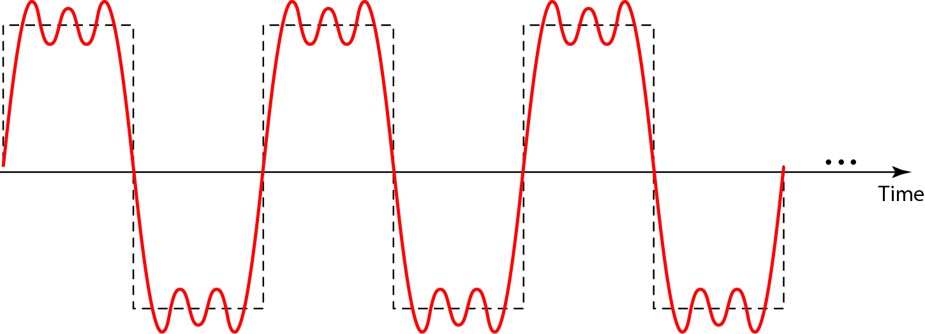
A composite periodic signal
A periodic composite signal with frequency f.

Slide 44
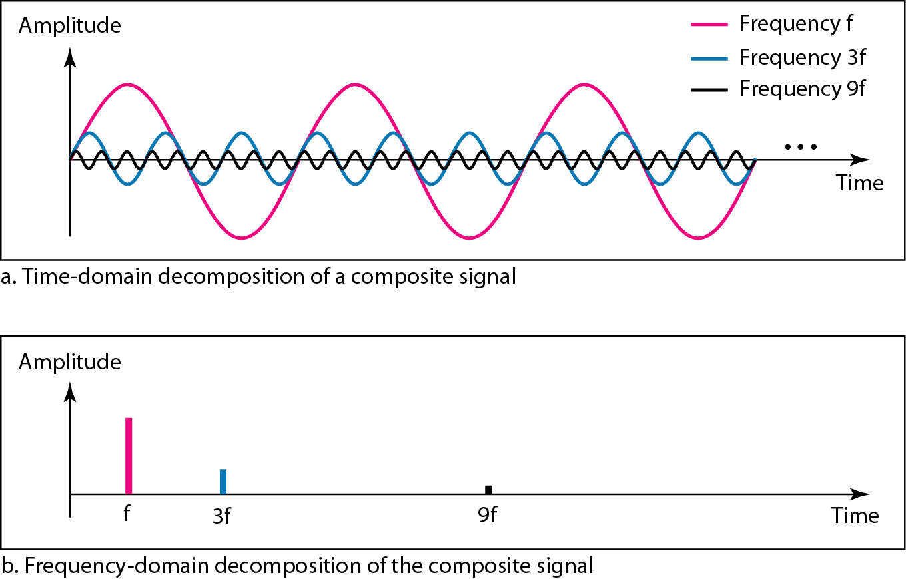
Decomposition of a composite periodic signal in the time and frequency domains

Slide 45
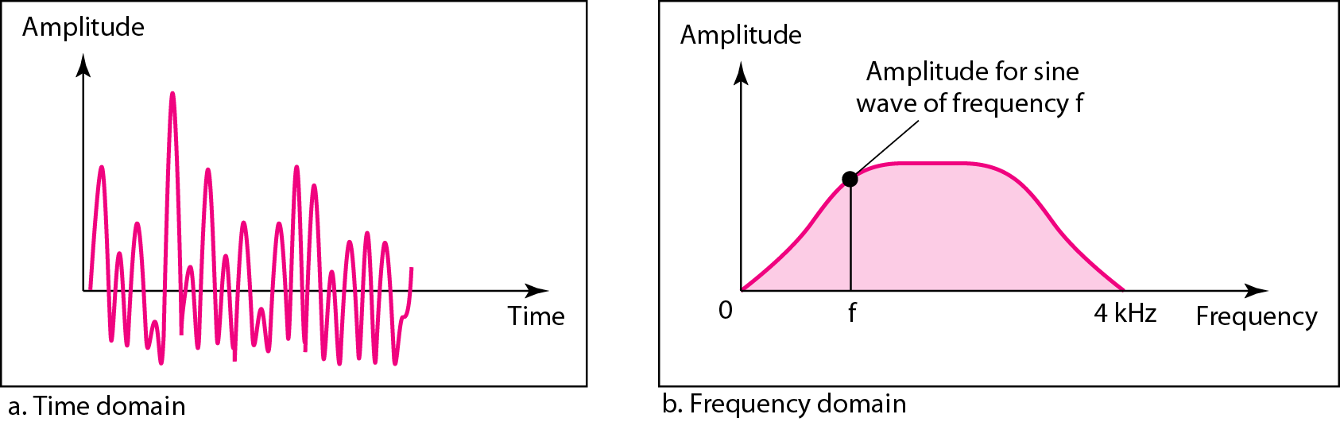
A nonperiodic composite signal

Slide 46
Bandwidth and Signal Frequency
Range of frequencies that a medium can pass without losing one-half of the power contained in the signal
Difference between the highest and the lowest frequencies that the medium can satisfactorily pass.
Bandwidth refers to the property of a medium or the width of a single spectrum.

Slide 47
Bandwidth

Slide 48
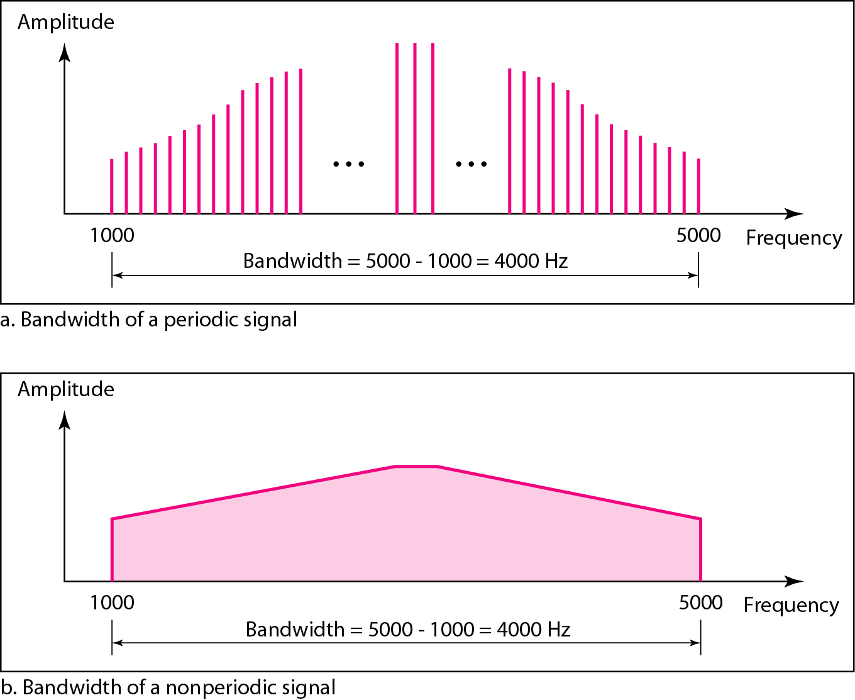
The bandwidth of periodic and nonperiodic composite signals

Slide 49
Bandwidth can be defined as the portion of the electromagnetic spectrum occupied by the signal
It may also be defined as the frequency range over which a signal is transmitted.
Different types of signals have different bandwidth. Ex. Voice signal, music signal, etc.
Bandwidth of analog and digital signals are calculated in separate ways; analog signal bandwidth is measured in terms of its frequency (hz) but digital signal bandwidth is measured in terms of bit rate (bits per second, bps)
Bandwidth of signal is different from bandwidth of the medium/channel

Slide 50
Bandwidth of an analog signal
Bandwidth of an analog signal is expressed in terms of its frequencies.
It is defined as the range of frequencies that the composite analog signal carries.
It is calculated by the difference between the maximum frequency and the minimum frequency.
If minimum frequency of F1 = 30Hz and maximum frequency of F2 = 90Hz, then the bandwidth is given by F2 – F1 = 90 – 30 = 60 Hz

Slide 51
Absolute Bandwidth of Analog Signal
width of signal spectrum: B = f_{highest} - f_{lowest}
Effective Bandwidth of Analog Signal
range of frequencies where signal contains most of its power/energy
Frequency Spectrum of Analog Signal
range (set) of frequencies that signal contains

Slide 52
Bandwidth of a digital signal
It is defined as the maximum bit rate of the signal to be transmitted.
It is measured in bits per second

Slide 53
BANDWIDTH OF A CHANNEL
A channel is the medium through which the signal carrying information will be passed.
In terms of analog signal, bandwidth of the channel is the range of frequencies that the channel can carry.
In terms of digital signal, bandwidth of the channel is the maximum bit rate supported by the channel. i.e. the maximum amount of data that the channel can carry per second.
The bandwidth of the medium should always be greater than the bandwidth of the signal to be transmitted else the transmitted signal will be either attenuated or distorted or both leading in loss of information.
The channel bandwidth determines the type of signal to be transmitted i.e. analog or digital.

Slide 54
THE MAXIMUM DATA RATE OF A CHANNEL
Data rate depends on three factors:
The bandwidth available
The level of the signals we use
The quality of the channel (the level of noise)
The quality of the channel indicates two types:
a) A Noiseless or Perfect Channel
An ideal channel with no noise.
The Nyquist Bit rate derived by Henry Nyquist - gives the bit rate for a Noiseless Channel.
b) A Noisy Channel
A realistic channel that has some noise.
The Shannon Capacity formulated by Claude Shannon - gives the bit rate for a Noisy Channel

Slide 55
Nyquist Bit Rate
The Nyquist bit rate formula defines the theoretical maximum bit rate for a noiseless channel
Bitrate = 2 x Bandwidth x Log₂ L
Where
Bitrate is the bitrate of the channel in bits per second
Bandwidth is the bandwidth of the channel
L is the number of signal levels.

Slide 56
Shannon Capacity
The Shannon Capacity defines the theoretical maximum bit rate for a noisy channel
Capacity=bandwidth X log₂ (1 +SNR)
Where
Capacity is the capacity of the channel in bits per second
Bandwidth is the bandwidth of the channel
SNR is the Signal to Noise Ratio
Shannon Capacity for calculating the maximum bit rate for a noisy channel does not consider the number of levels of the signals being transmitted as done in the Nyquist bit rate.

Slide 57
Frequency Spectrum
Description of a signal using the frequency domain and containing all of its components
The spectrum of a signal is the range of frequencies that it contains.
Dependent on medium used

Slide 58
Frequency spectrum comparison

Slide 59
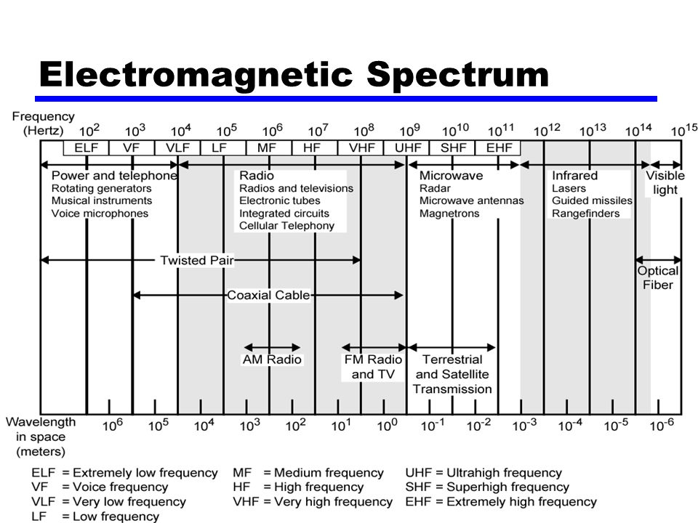
Frequency Spectrum

Slide 60
Composite Signals and Transmission Medium
A medium’s characteristics may affect the signal
Some frequencies may be weakened or blocked
Signal corruption – when square wave is sent through a medium, other end which is not square wave at all

Slide 61
no transmission medium is perfect – each medium passes some frequencies and blocks or weakens others
• composite signal sent at one end of transmission medium (comm. channel), may not be received in the same form at the other end
• passing a square wave through any medium will always deform the signal !!!

